Slide 1




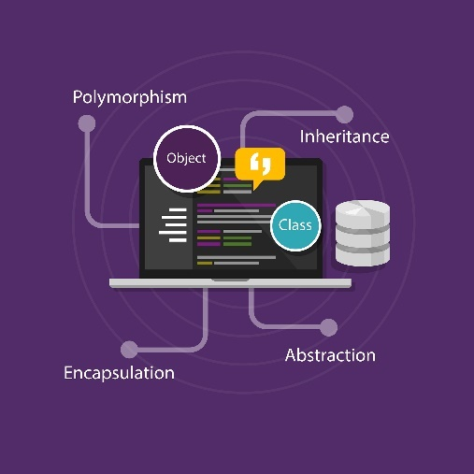
OOP Advanced
Course Overview
Java OOP
SoftUni Team
SoftUni Team
Software University
http://softuni.bg

Slide 2

Table of Contents
Interfaces & Abstraction
Generics
Enums and Annotations
Reflection
Unit Testing
SOLID

Slide 3
Have a Question?
sli.do #JavaFundamentals

Slide 4
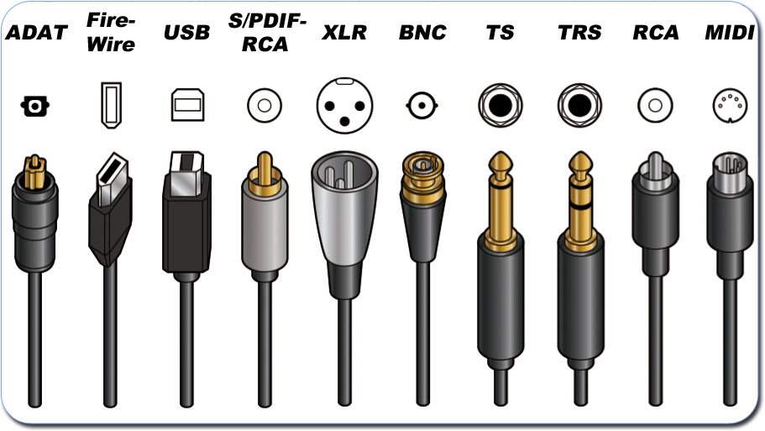
Abstraction
Interfaces

Slide 5

Abstraction in OOP
Abstraction means ignoring irrelevant features, properties, or functions and emphasizing the relevant ones
... relevant to the project we develop
Abstraction helps managing complexity
"Relevant" to what?
Notes:
Abstraction means ignoring irrelevant features, properties, or functions and emphasizing the relevant ones, relevant to the project we develop.
Abstraction helps managing complexity
Abstraction is something we do every day:
Looking at an object, we see those things that have meaning to us and ignore all others.
Represent a complex reality with a simplified model.
In a bank application, customers have:
name, phone and address, but they don’t have :
hair color and favorite drink, which we are disregarded from.

Slide 6
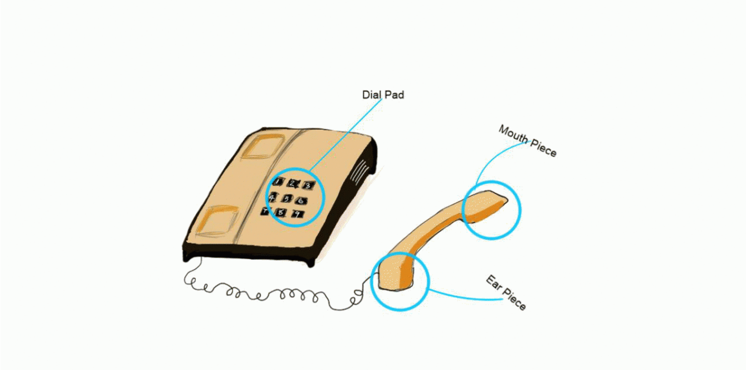
Abstraction Example
Abstraction lets you focus on what the object does instead of how it does it.
Notes:
Abstraction means ignoring irrelevant features, properties, or functions and emphasizing the relevant ones, relevant to the project we develop.
Abstraction helps managing complexity
Abstraction is something we do every day:
Looking at an object, we see those things that have meaning to us and ignore all others.
Represent a complex reality with a simplified model.
In a bank application, customers have:
name, phone and address, but they don’t have :
hair color and favorite drink, which we are disregarded from.

Slide 7


Interface
Shared boundary across which two or more separate components exchange information
Notes:
There are two ways to achieve abstraction
- Using Abstract Classes
- Using Interfaces

Slide 8

Generics
Reusing Classes

Slide 9
Generics Classes
T - used anywhere inside the class
Your class is generic – e.g. you can use it with any type
public class List<T> {
public void add(T item) {}
public T get(int index) {}
}
List<Apple> apples = new List<>();
apples.add(new Apple);
Apple apple = aplles.get(0);
Notes:
There are two ways to achieve abstraction
- Using Abstract Classes
- Using Interfaces

Slide 10
Enumeration
A set of predefined constants
Results in a cleaner code
public enum Priority {
HIGH, MEDIUM, LOW
}
Error error = new Error(Priority.HIGH);
…
if (error.getPriority.equals(Priority.HIGH)) { … }
Notes:
There are two ways to achieve abstraction
- Using Abstract Classes
- Using Interfaces

Slide 11
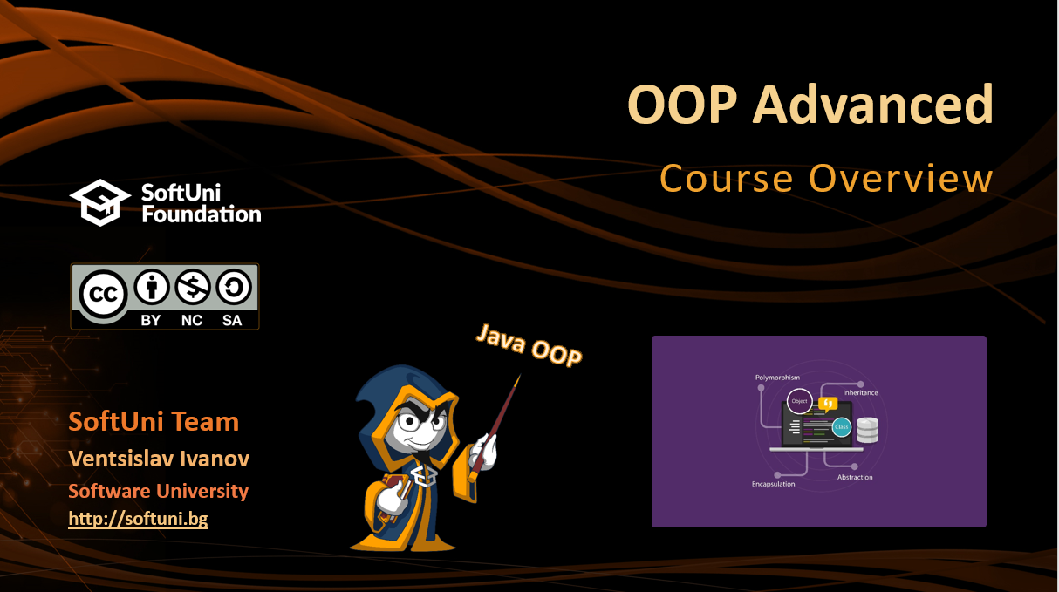
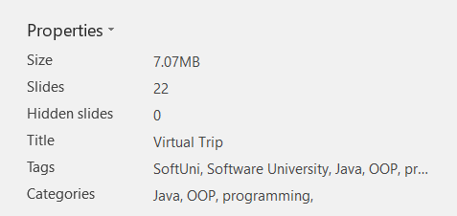
Annotations
Provide metadata (data about the data)
@Override
String toString() { ... }
@Test
void testSetAge() { ... }
Notes:
There are two ways to achieve abstraction
- Using Abstract Classes
- Using Interfaces

Slide 12

Reflection
Runtime Type Information

Slide 13
Reflection
Can inspect Java classes at runtime
Using the Class
Class catClass = cat.class
int modifiers = catClass.getModifiers();
Class[] interfaces = catClass.getInterfaces();
Method[] method = catClass.getMethods();
Field[] method = catClass.getFields();
Annotation[] annotations = catClass.getAnnotations();

Slide 14

Unit Testing
Developer Job

Slide 15
Unit Testing
Individual modules are tested to find bugs
The main aim is to isolate each unit of the system to identify, analyze and fix the defects
@Test
public void testFeedShouldNotLeaveCatHungry() {
Cat cat = new Cat();
cat.feed();
Assert.assertTrue(cat.isFed());
}

Slide 16
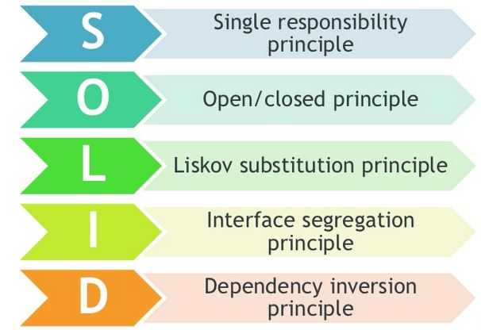
SOLID Principles

Slide 17
SOLID
Single responsibility principle
Class should have only a single responsibility
Open/closed principle
“software entities … should be open for extension, but closed for modification.”
Liskov Substitution Principle
Objects in a program should be replaceable with instances of their subtypes without altering the correctness of that program.

Slide 18

SOLID
Interface segregation principle
Many client-specific interfaces are better than one general-purpose interface
Dependency inversion principle
"depend upon abstractions, NOT concretions"

Slide 19





Trainings @ Software University (SoftUni)
Software University – High-Quality Education, Profession and Job for Software Developers
softuni.bg
Software University Foundation
http://softuni.foundation/
Software University @ Facebook
facebook.com/SoftwareUniversity
Software University Forums
forum.softuni.bg

